Slide 1
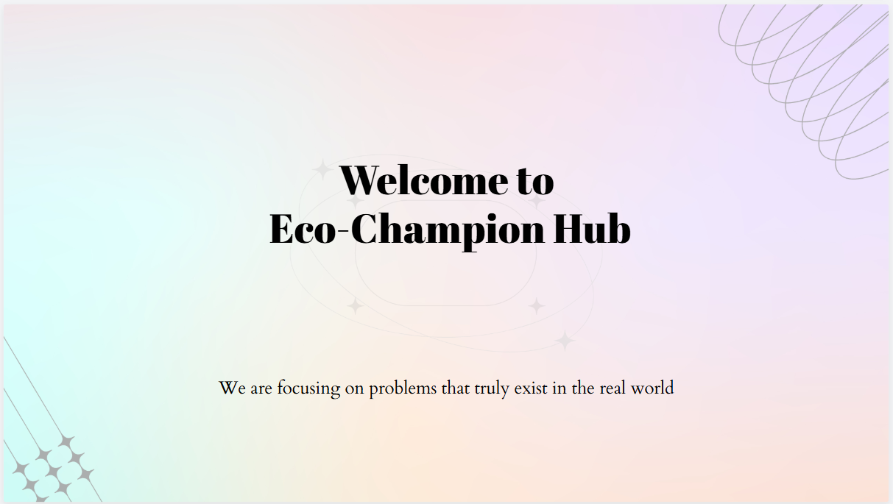
"Sustainability is not a choice; it is our promise to the future. Every drop saved, every tree planted, and every life uplifted brings us closer to a world where nature and humanity thrive together."
Visit our website : https://eco-champion-hub.netlify.app/

Slide 2
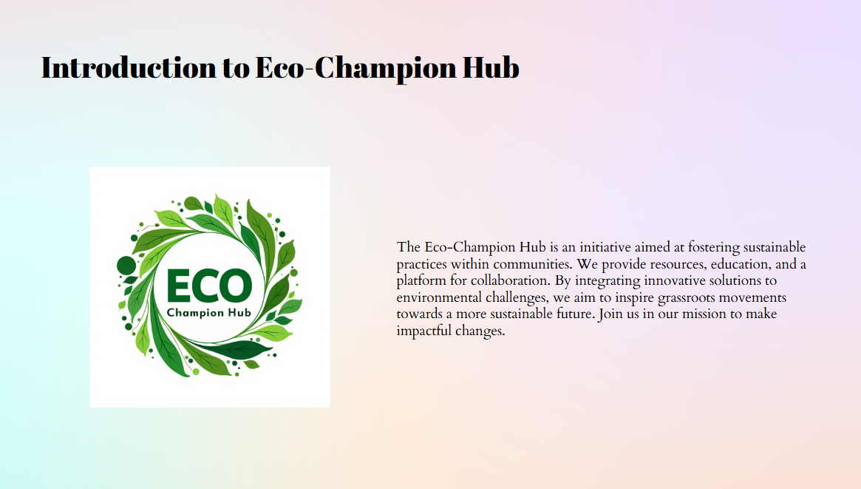

Slide 3
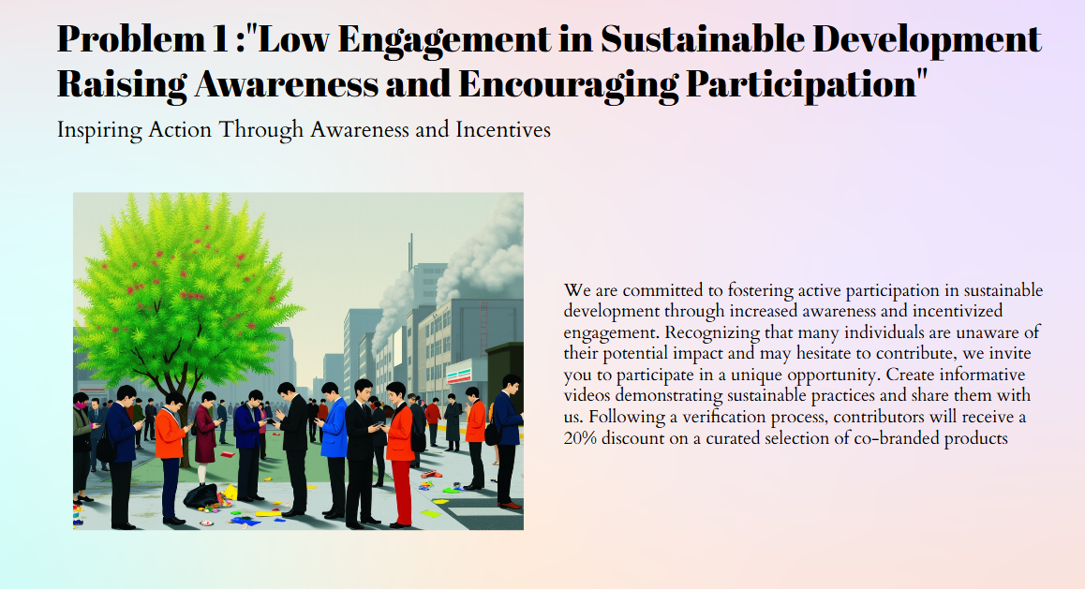

Slide 4
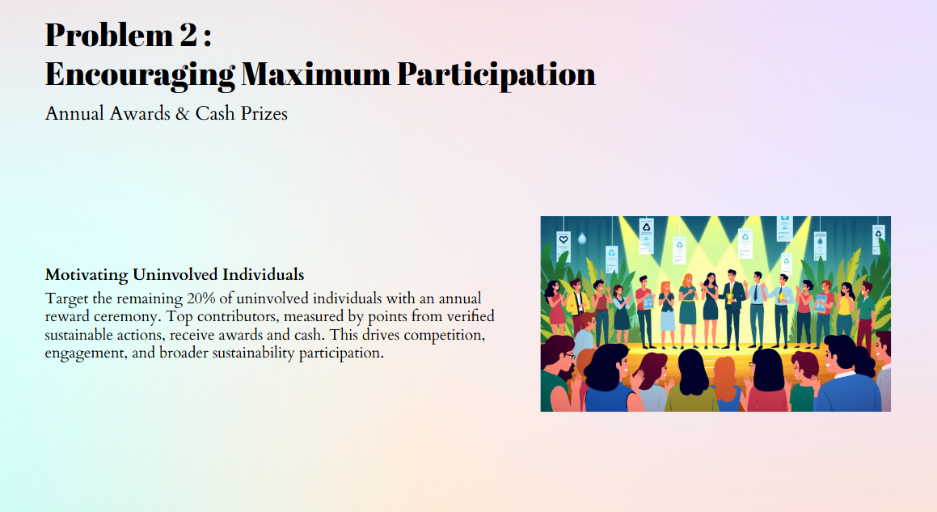

Slide 5
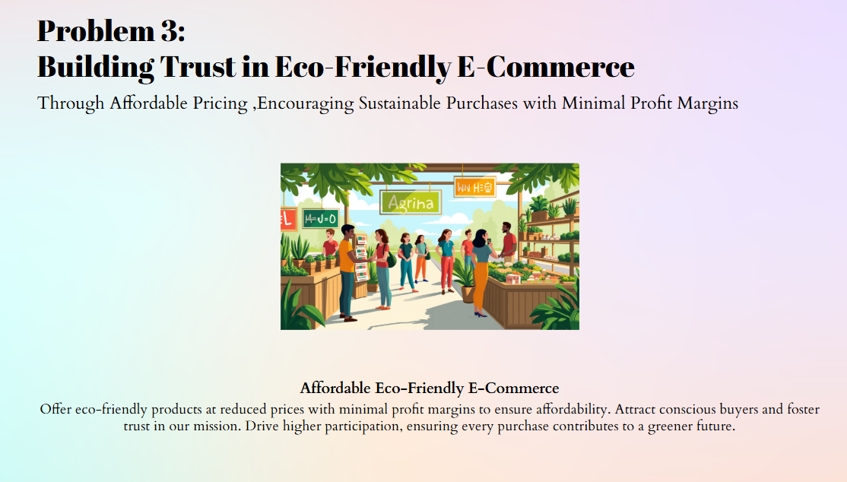

Slide 6
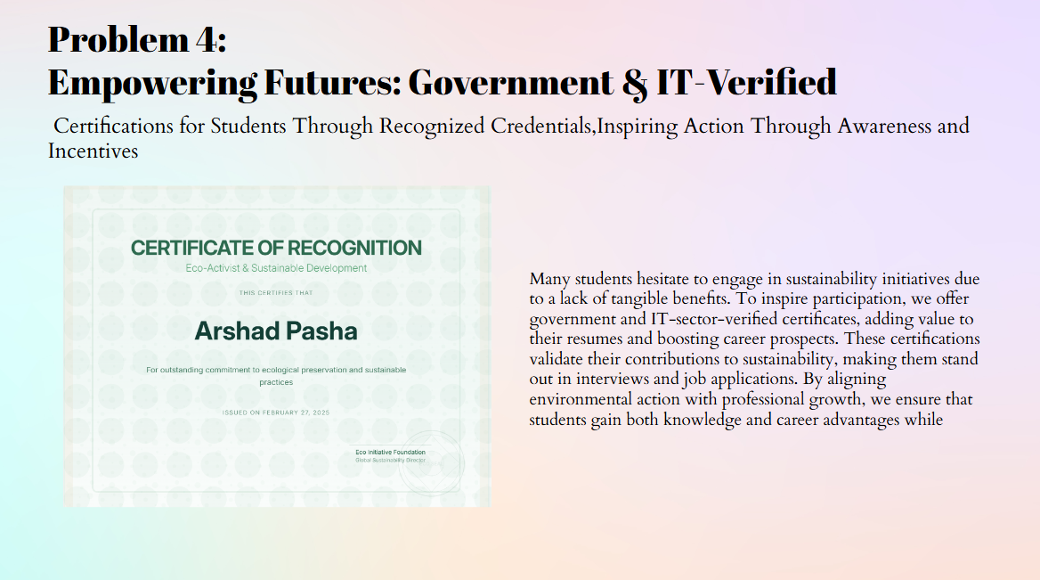

Slide 7
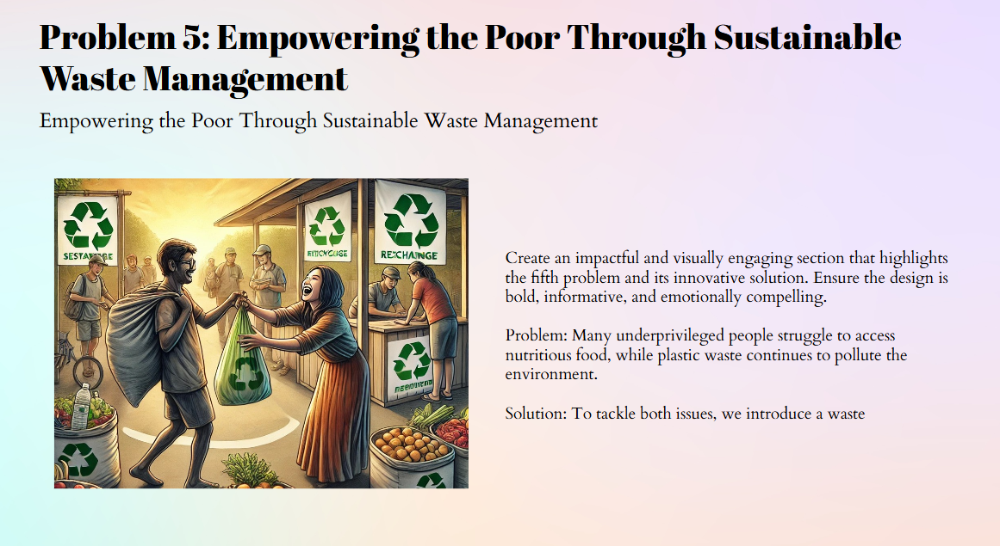

Slide 8


Slide 9



By offering incentives such as discounts and rewards for participation in sustainability initiatives, you provide economic benefits to underprivileged communities, aiding in poverty alleviation.
The waste-to-food exchange program directly addresses hunger by providing fresh fruits in exchange for plastic waste, ensuring access to nutritious food for those in need.
Promoting a cleaner environment through waste management initiatives contributes to improved public health and well-being.

Slide 10



Offering government and IT-verified certifications encourages students to engage in sustainable practices, enhancing their education and future employment prospects.
Incentivizing participation in sustainability efforts creates job opportunities and promotes economic growth within communities
Empowering marginalized groups through inclusive programs helps reduce social and economic inequalities.

Slide 11



Implementing effective waste management practices contributes to the development of sustainable and resilient communities.
Encouraging the collection and recycling of plastic waste promotes responsible consumption and production patterns.
Reducing plastic waste and promoting sustainable practices contribute to mitigating climate change impacts.

Slide 12
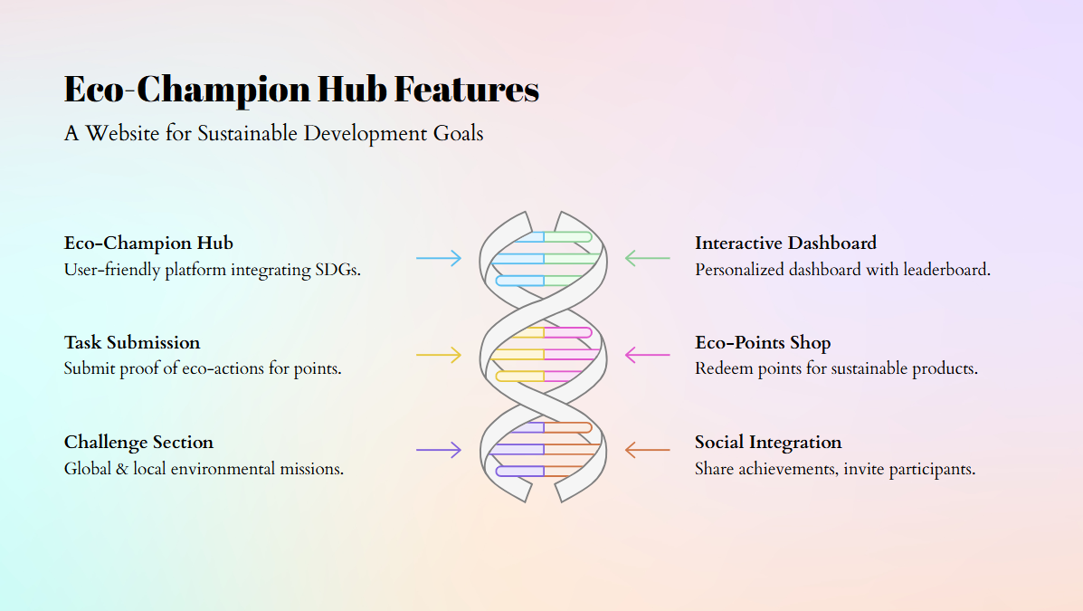

Slide 13
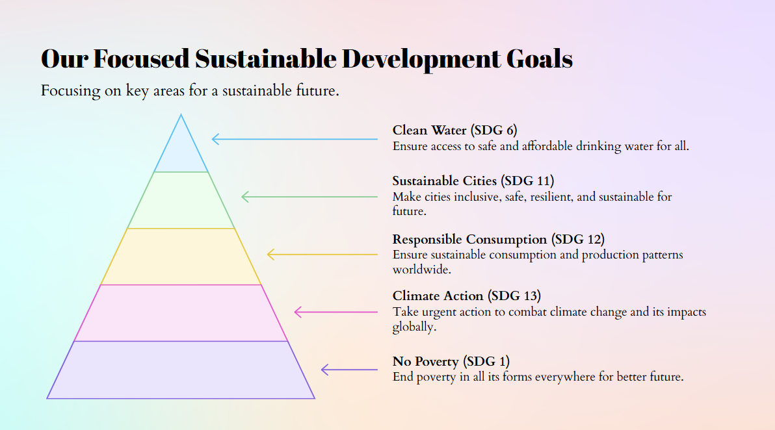

Slide 14
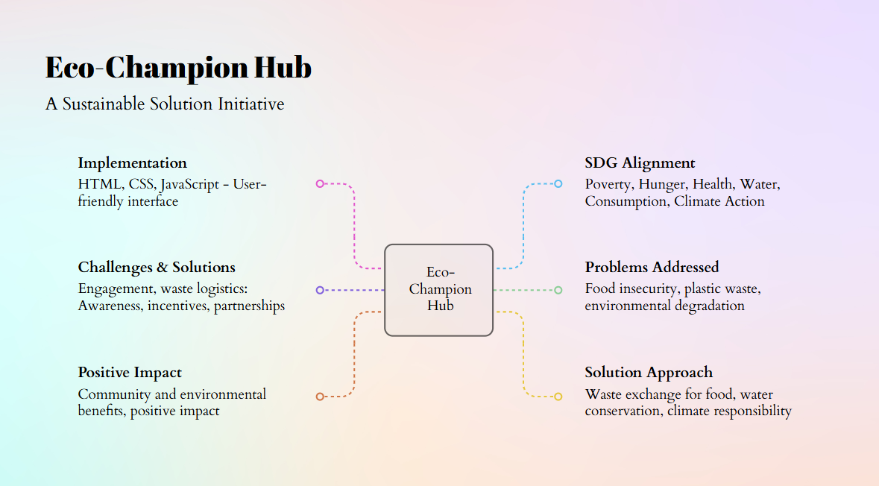

Slide 15
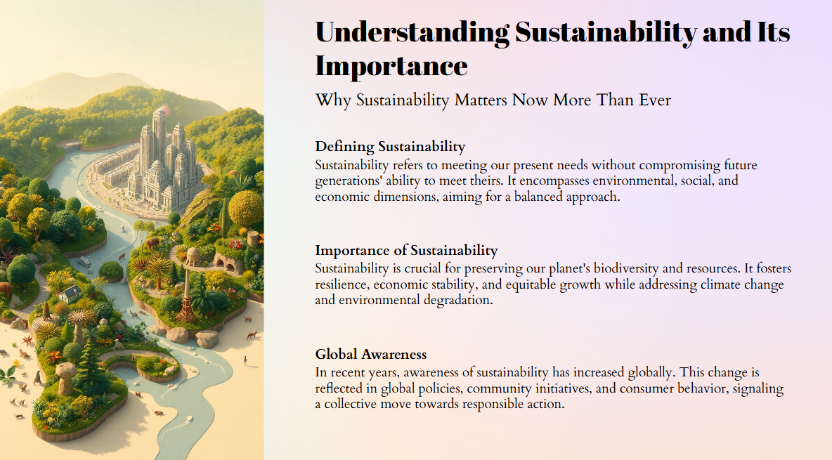

Slide 16

Report …..

